Slide 1
Remote effects: resective surgery on complex networks
Thomas Campbell Arnold
Notes:
Thank you for being here. Today I’m going to present work on a project I assumed shortly after joining the lab. The remote effects project was originally conceived by Lohith, so you can blame him for any conceptual flaws.

Slide 2
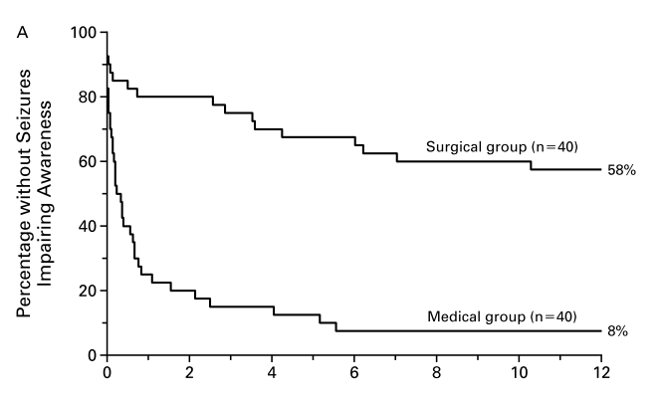
Epilepsy Surgery
Wiebe et al. 2001
Notes:
To start off, I want to provide a little background on epilepsy surgery. For patients with DRE, epilepsy surgery to remove a putative seizure onset zone is the gold-standard of care. The figure on the right is a Kaplin-Meyer curve from a seminal paper by Wiebe et al. T

Slide 3
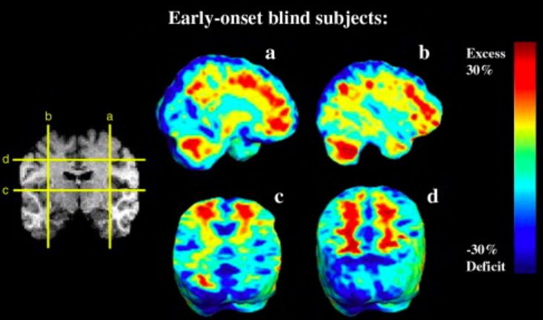
Motivation
Complex network
Systemic injury
Hypertrophy and atrophy
Notes:
1. The brain is characterized as a network of interdependent regions that carry out complex tasks.
2. After surgery, patients still have to content with these complex tasks, however there are gross alterations to their functional anatomy.
3. Generally in systems that have been compromised there is some restructuring that reflect alterations and attempt to maintain functionality.
4. A simple example of this is when I broke my tibia and fibula. I lived in a tight house and crutches weren’t really feasible to use, so I started hopping around on my other leg. By the end of 4 months my left leg looked like Andy’s biceps, but my right thigh had wasted away.
5. This pattern of hypertrophy and atrophy is common in leg injuries. The local and highly connected components of the system atrophy due to decreased use of the broken leg, while other task associated components hypertrophy as they attempt to carry out the same task.
6. Our expectation is that we will find a similar effect in the brain after resections.
7. In fact Leporé et al. 2010 demonstrated that changes in brain morphology that were associated with blindness.
Work in fact that leg-dominance changed to left during injury and has never reverted. Indicating permanence of compensatory responses.
Maybe age related (happened when I was 12/13 so was still learning left from right)

Slide 4
Currently available data
Vanderbilt
UPenn
23 patient
Surgical distribution
7 L Amygdalohippocampectomy
10 R Amygdalohippocampectomy
7 RATL
3 w/ prior surgery (likely excluded)
Imaging at 1-5 years post-op
One pre, one post
21 patients
Surgical distribution
7 LATL (1+)
8 RATL
6 other/?
Multiple images, varies by subject

Slide 5
Pipeline
Native Space
Single Subject Template Space
Nick Oasis Template Space
T1-pre
NOT
& priors
SST
T1-post
Cooked
priors
CT maps
CT maps

Slide 6

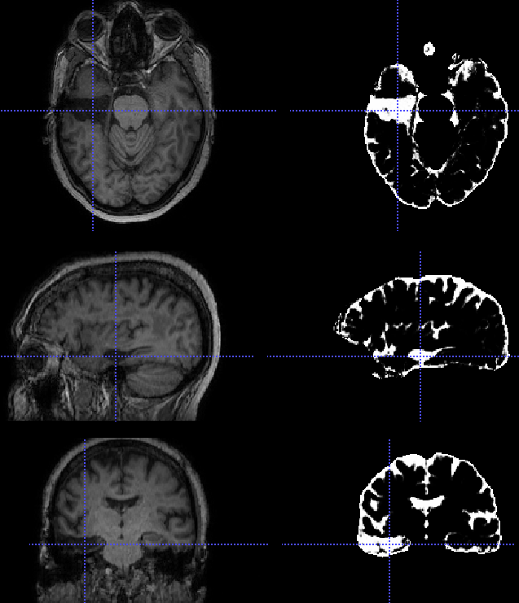
CSF prior captures lesion
Notes:
Looking at the tissue segmentations, I noticed that the CSF prior seemed to be capturing the resection zone in post-resection imaging. Wondered if I could capitalize on this for automated segmentation.

Slide 7

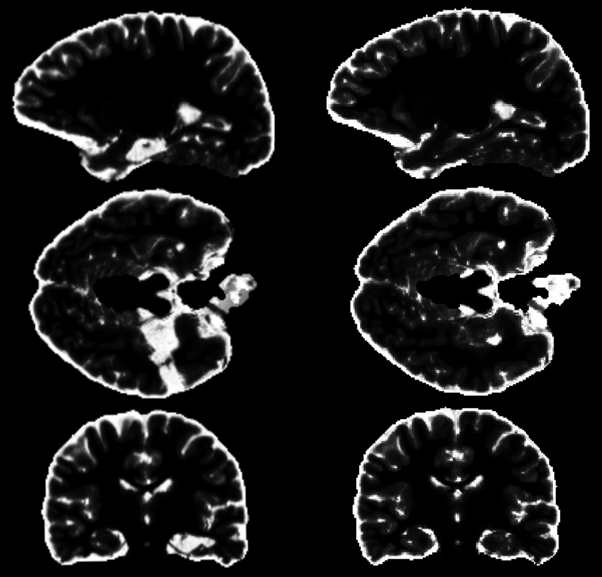



Post-Resection Pre-Resection Resection
Notes:
My initial idea was to subtract the pre-resection from the post-resection. This removes the CSF surrounding the brain and bathing the ventricles, leaving only the resection zone.
There are some artifacts in the raw subtraction, but applying a smoothing kernel and using voxel cluster detection cleans up the segmentations fairly efficiently.

Slide 8
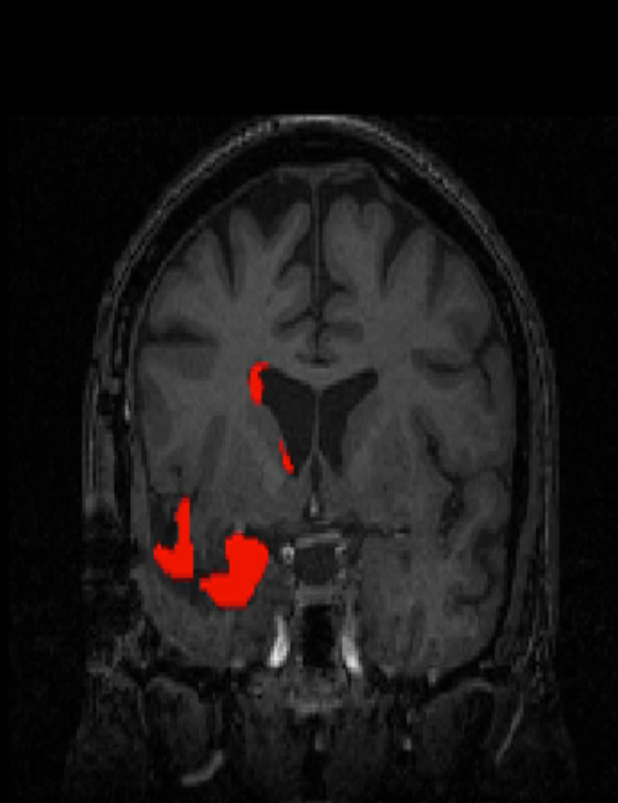
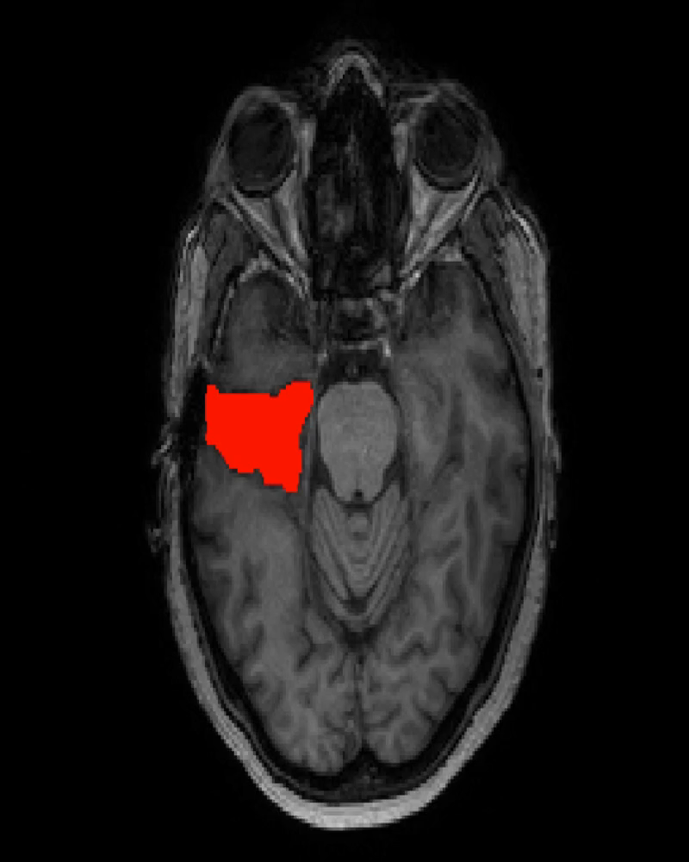
The good…
The bad…
Notes:
All automated segmentations localize a portion of the resection zone. The right exhibits the largest problem with the pipeline, inclusion of the ventricular boarder in the segmentation. This results from ventricular distortion that occurs from pre-to-post. You can also see that not all resected tissue is labeled in the attached image.

Slide 9
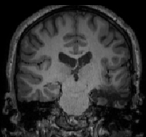
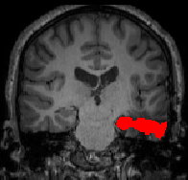
UNets: Deep learning for resections
224x224x32
224x224x32
Input image
112x112x64
112x112x64
labeled frame
56x56x128
56x56x128
3x3
28x28x64
14x14x128
28x28x64
Convolution + ReLu Layer
Deconvolution + Concatenation Layer
Pooling Layer
¹Ronneberger, et al. MICCAI. 2015:9351:234-4!

Slide 10
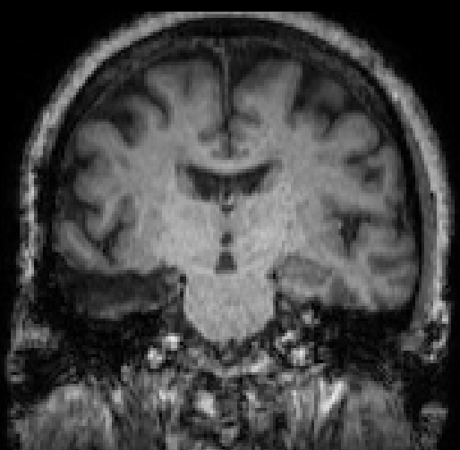
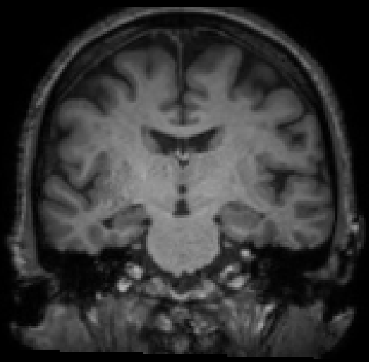
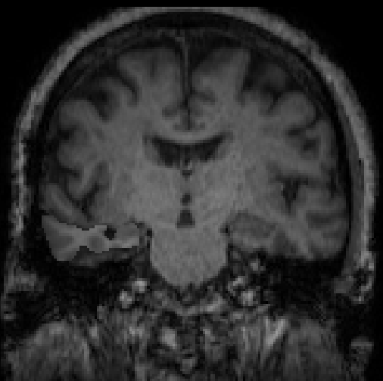
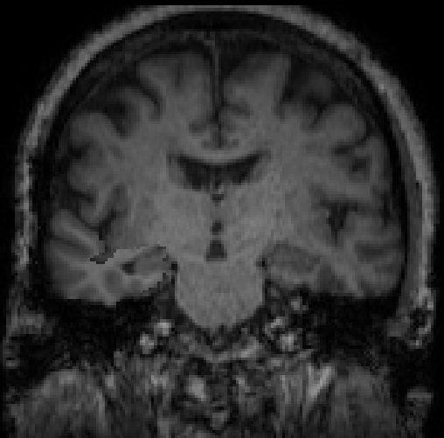
Promising idea from Chris Olm
Notes:
Use the resection zone to perform a virtual implantation.
Allows you to use the longitudinal cortical thickness pipeline as intended.
Built in control regions which should not change from pre to post.
Probably desirable to smooth the boarders and perform histogram matching.

Slide 11
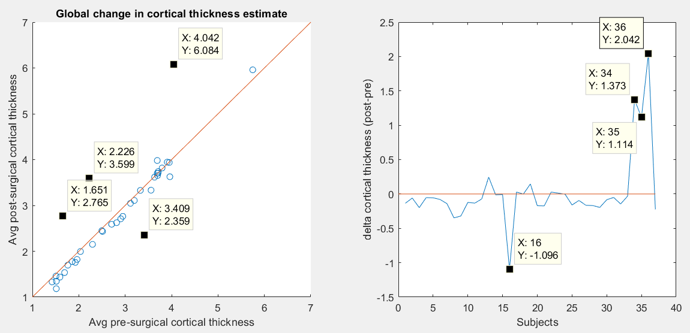
Global Cortical Thickness Changes
Notes:
A select number of subjects exhibit global changes in cortical thickness. I consulted with Sandy, this likely reflects a lack of contrast between the cortex and the CSF. He suggested correcting the cortical thickness estimates by removing the global change in CT.

Slide 12
Correction of global cortical thickness changes
Difference in cortical thickness
Corrected difference
Contralateral
Contralateral
Ipsilateral
Ipsilateral
Subjects
Subjects

Slide 13
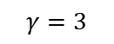
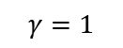
Testing fmri connectivity on flywheel – Power264
$$γ=1$$
$$γ=3$$
Uncertain
Sensory/somatomotor Hand
Sensory/somatomotor Mouth
Cingulo-opercular Task Control
Auditory
Default mode
Memory retrieval?
Visual
Fronto-parietal Task Control
Salience
Subcortical
Ventral attention
Dorsal attention
Cerebellar

Slide 14
Modularity comparisons
Gamma = 1, Q = 0.8701, MI = 0.2976
Gamma = 3, Q = 0.3937, MI = 0.4819

Slide 15
Testing fmri connectivity on flywheel
 |  | Uncertain
 |  | Sensory/somatomotor Hand
 |  | Sensory/somatomotor Mouth
 |  | Cingulo-opercular Task Control
 |  | Auditory
 |  | Default mode
 |  | Memory retrieval?
 |  | Ventral attention
 |  | Visual
 |  | Fronto-parietal Task Control
 |  | Salience
 |  | Subcortical
 |  | Ventral attention
 |  | Cerebellar
 |  | Dorsal attention
Notes:
Q=0.8701
Didn’t alter gamma, can see higher resolution communities.

Slide 16
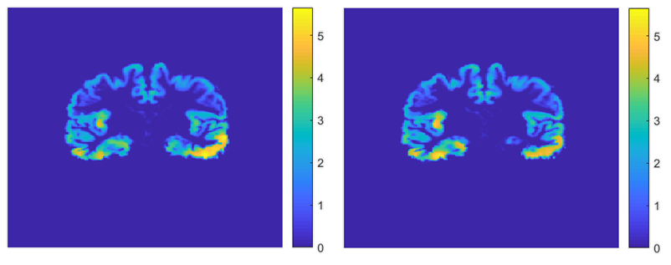
Visualization of slice after normalization
Notes:
Cortical_thickness_analysis_v1_0
SUB '25’ LATL

Slide 17
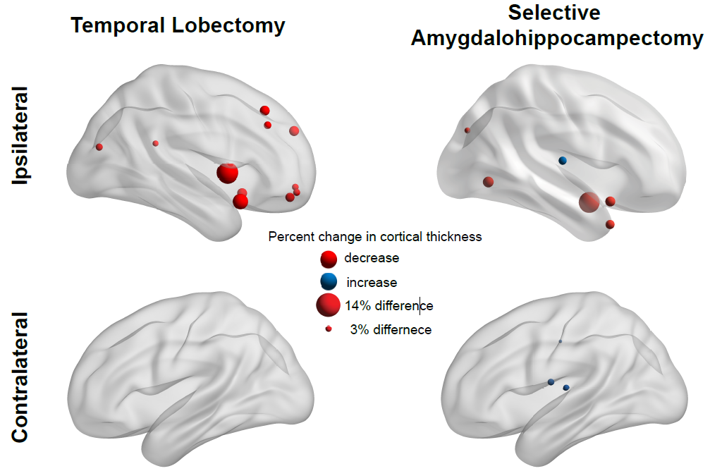
Notes:
(left) Patients that received a temporal lobectomy predominantly exhibited diffuse decreases in cortical thickness throughout the ipsilateral frontal lobe. No affects were seen in the contralateral hemisphere.
(right) Patients that recieved a selective amygdalahippocampectomy demonstrated decreases in the temporal pole and occipital lobe. Additionally, increases in cortical thickness were seen bilaterally in Heschl gyrus and contralaterally in the cingulum.

Slide 18

Reviewer 2
Me: “Hey John, can you…”
Bonferoni
correction
JOHN
Publishing
In BRAIN

Slide 19
Epilepsy Surgery

